Slide 1
KNH 203: Diabetes
Maddi Kelly and Megan Beyer
Group 2

Slide 2
Patient Profile
Diabetes Dave
25 year old male
190 lbs
Type 1 diabetes
Moderately active → 30-60 min
moderate/vigorous activity a day
Daily Calorie Need: 3000 kcal/day
Carb need: 94 grams
Protein need: 47 grams
Fat need: 21 grams

Slide 3
Our Meal & Needs
Carbohydrates
Grams = 93.7 g/meal and 46.9 g/snack
Servings = 6 servings/meal and 3 servings/snack
Fats
Grams = 46.9 g/meal and 23.4 g/snack
Servings = 6 servings/meal and 3 servings/snack
Protein
Grams = 20.8 g/meal and 10.4 g/snack
Servings = 4 servings/meal and 2 servings/snack

Slide 4
Menu
Main Entree- Oven Barbecued Chicken
Vegetarian Entree- Roasted Veggie Pitas
Vegetable- Raspberry Mango Salad
Starch side- Roasted Cauliflower, Sweet Potatoes, and Onions
Bread- Zucchini and Date Muffins
Fruit- Baked Cinnamon Stuffed Apples
Soup- Chicken and Wild Rice
Dessert- Cranberry Oatmeal Cookies
Drink- Holiday Spiced Tea

Slide 5
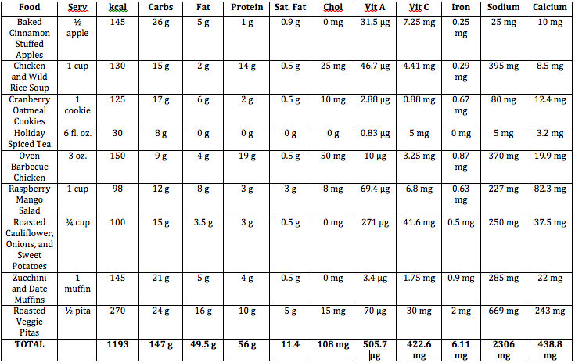
Nutrient Analysis

Slide 6
Possible Meal Options
Menu 1: Pita, soup, vegetable, cookie
Carbs = 71 g
Protein = 29 g
Fat = 27.5 g
Menu 2: Chicken, salad, muffin, apples, tea
Carbs = 76 g
Protein = 27 g
Fat = 22 g
Menu 3: Chicken, vegetable, salad, muffin, apples, tea
Carbs = 86 g
Protein = 30 g
Fat = 25.5 g

Slide 7
Health Benefits
- Maintain blood sugar
- Count carbohydrates
- 2 to 1 ratio of carbohydrates to protein
(1 to 1 servings)
Eat regular meals, 3 meals a day and 2 snacks and DON’T SKIP!

Slide 8
Why?
We chose are menu because we wanted:
To use varied textures, flavors and cooking techniques.
To base the menu off of carbohydrate counting as that is easiest for a diabetic.
To find recipes easily accessible to diabetics with easily accessible nutrition information.
To keep our meals exciting to prove that you can still eat well and enjoy your food while living with diabetes.

Slide 9
Implement Menu
Using visual representations
Flavor taste testings
Discuss current eating habits and compare them to the menu we have in similar overlap
Recreating favorite foods in a healthier way
Give many options to fit a wide range of cravings and flavors
Explain the Exchange System and the Plate Method to allow personal choice and diversity in the diet

Slide 10
Video
https://www.youtube.com/watch?v=cQclTrqppD0&spfreload=10

Slide 11
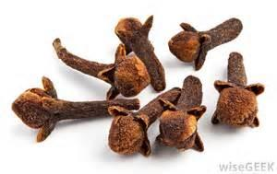
Cloves
Unopened pink flower buds of the evergreen clove tree
Nutrient-dense spice:
Manganese, vitamin K, fiber, iron, magnesium, calcium
Contains eugenol which is an active component that prevents toxicity from environmental pollutants such as carbon tetrachloride, digestive tract cancers, and joint inflammation
Includes high anti-inflammatory components and can decrease symptoms by 15-30%.

Slide 12
Cooking with Clove
Pierce an onion with whole cloves and add to soups or broths
Adding ground cloves and curry powder to healthy sautéed onions and garlic will create an Indian inspired dish
Improve apple cider by adding ground cloves and cinnamon
Spice up fruit by adding ground cloves
Add clove powder, walnuts, and raisins to a favorite Thanksgiving stuffing recipe
Add to your daily tea (like us!)

Slide 13
LADA= 1.5
 | Type 1 | LADA | Type 2
Typical Age | Adult or youth | Adult | Adult
Progression of I.D. | Rapid (days-weeks) | Latent (months-years) | Slow (years)
Insulin dependence | At diagnosis | Within 6 years | Over time (if at all)
Insulin Resistance | No | Some | Yes

Slide 14
Type 1 Diabetes, Type 2 or 1.5?
Type 1, Type 2 or 1.5?
I am sure you have recently seen the news about diabetes 1.5, but what exactly is diabetes 1.5 and what is all the hype? Diabetes 1.5 is also called latent autoimmune diabetes (LADA) in adults and is most common under age 35. LADA diabetes is a cross between type 1 and type 2, containing characteristics of each type. LADA is slowly progressing and often is misdiagnosed as type 2. As there currently is a lot of unknown information about LADA upon how it is defined, how it develops its importance for the patient. The autoimmune disease was found by doing a study for type 1-diabetes patients to see if they had autoantibodies, which they found they did because type 1 is an autoimmune disease. Then they decided to test it in type 2 patients and found that most did not have it except 10% had these autoantibodies, which led scientist to conclude there is another subcategory of diabetes. Although there is information available about diabetes, be sure to continuously keep informed especially if you have type 1 or type 2-diabetes.

Slide 15
Management Roles
Decided on menu together
Maddi did the nutritional analysis while Megan compiled the recipes and completed the market order
Maddi completed the pamphlet and Megan completed the blog
We worked together in making sure we did not forget anything through the planning process

Slide 16
References
http://www.whfoods.com/genpage.php?tname=foodspice&dbid=69
http://www.mayoclinic.org/diseases-conditions/diabetes/expert-blog/types-of-diabetes/bgp-20056516
http://www.diabetesforecast.org/2010/may/the-other-diabetes-lada-or-type-1-5.html

