Slide 1
Healthy Hut
An Employee Wellness Cafeteria
Group 2: Sam Ballard, Connie Bisesi & Megan Beyer

Slide 2
Corporation Name & Overview
Cafeteria Name: Healthy Hut
Business Name: Just For The Health of It
Just For The Health of It is a corporation focusing on independent contracting with other companies offering corporate wellness programs. At the location featuring Healthy Hut, they have about 1,000 employees.
Notes:
Connie

Slide 3
Basic Menu Concept
Offering a corporate cafeteria featuring 6 individual stations including:
Wok This Way: stir fry and noodle bar
Lunch Box: sandwich bar
Chopped: soup and salad bar
Rise and Shine: hot breakfast bar
Hydration Station: drink bar offering coffee, tea, hot chocolate & smoothies
Snack Bar: snacks and bottled beverages
Healthy Hut allows for a huge variety for all customers of a la carte fresh food and personalized options exactly to one’s preferences. As a partner with the gym facility we encourage a healthy lifestyle and a balanced diet.
Notes:
Megan

Slide 4
Overview of Project
Healthy Hut provides healthy al a carte dining options for…
Breakfast served from 6 AM to 10 AM
Lunch served from 11 AM to 2 PM
Snack bar open from 6 AM to 4 PM
10,000 Sq.Ft facility offering a state of the art kitchen, elegant cafeteria seating, conference rooms, and outdoor seating
Plans to serve 200 people for breakfast, 300 people for lunch and an additional 100 for snacks throughout the day
Notes:
Connie

Slide 5
Our Mission and Vision
Mission Statement:
Strive to offer all employees of Just For The Health of It healthy and balanced options for any meal
Vision Statement:
To be the company that best understands and satisfies the health, and self-fulfillment needs of all employees of Just For The Health of It
Notes:
Megan

Slide 6
Timeline
January 2015
Prepare program planning guide with the rational and characteristics and purpose of the operation
Complete and verify kitchen and dining area build plan for completion in one year with project team
Discuss budget ideas for renovation and formally prepare a prospectus
Research funding and loans for the construction
Meet with facility administration to discuss ideas and opportunities for savings
Contact kitchen designer and architect for discussion on building plans, layout of facility
February 2015
Discuss renovation with other those involved in renovation of other parts of the facility for additional ideas
Contact regulatory agencies (see Regulatory agencies for more information)
Submit kitchen design to kitchen designer to process
Submit kitchen designer to architect ot process
Start the general contractor interviewing process
Notes:
Megan

Slide 7
Timeline (cont.)
March 2015
Architect complete with drawings and scope of work and equipment costs
Have multiple general contractors quote the project
Have multiple kitchen suppliers quote equipment through formal bid process
Consolidate all costs and prepare a proposal including savings
Acquire health and zoning permits
Gain approval for regulatory agencies
Make appropriate changes to plan from regulatory agencies and incorporate these
April 2015
Meet with project administrator and review proposal
Wait for project administrators and board approval of proposal
May 2015
Meet collectively with architect, kitchen provider and general contractor
Sign contracts
General contractor hires trades
Notes:
Megan

Slide 8
Timeline (cont.)
June, July 2015
Construction underway
Obtain fire, theft, liability and water damage insurance
Ensure installation and usage of power
August 2015
Advertise for new employees
Interview and select employees
September 2015
Equipment delivered and installed
All other supplies/ food products delivered and incorporated into completed facility
Staff and employees trained
October 2015
Final inspections by regulatory agencies
Make any necessary adjustments
November 2015
Menu testing
Punch list complete
Kitchen and dining are in full use and facility is running
December 2015
Grand opening of Healthy Hut
May 2016
Punch list walk- through with architect, kitchen provider, and general contractor
Notes:
Megan

Slide 9
Regulatory Agencies
U.S. Department of Labor
OSHA (Occupational Safety & Health Administration)
Ohio Department of Health--Food Safety Program
USDA
USFDA
Cleveland Department of Health
Notes:
Connie

Slide 10
Government Regulations
Social Security Act
Fair Labor Standard Act
Civil Rights Act
Family and Medical Leave Act
The Age Discrimination in Employment Act of 1967
*All labor laws that regulate how employees are hired, treated, or let go
Notes:
Connie

Slide 11
Logo
Notes:
Sam

Slide 12
Promotion & Incentives
Punch cards are available from gym facility. With your employee I.D. you are required to scan into the gym each time. Once you scan in 5 times, you are able to receive a 50% discount on an item from the on-the-go snack bar or drink bar.
Employee I.D. will allow items to be scanned into a personal account to which customers are able to view online or on an app. Within the program, purchased foods will be shown, categorized by day. Each day will give the employee nutrient information such as calories consumed, vitamins, and food groups based on what he/she purchased.
Barcode system used to look at food groups that are purchased within a day. Requires customer to purchase protein, grain, fruit, and vegetable and this would allow for a 10% discount toward their next purchase.
Notes:
Megan

Slide 13
Marketing
Monthly Healthy Hut Kitchen Newsletter
Healthy Hut Cafeteria Flyer
Company Gym Flyer
Healthy Hut Twitter Page
Sample Business Card
Menu Boards
Notes:
Sam

Slide 14
Marketing
Healthy Hut Kitchen Monthly Newsletter
Issue 1, December 2015
Notes:
Sam

Slide 15
Notes:
Sam

Slide 16
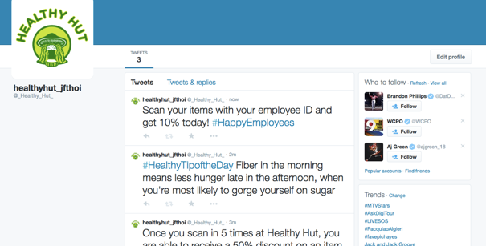
Marketing
Notes:
Sam

Slide 17
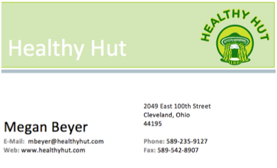
Marketing
Business Card
Notes:
Sam

Slide 18
Station Menu Boards
Notes:
Megan

Slide 19
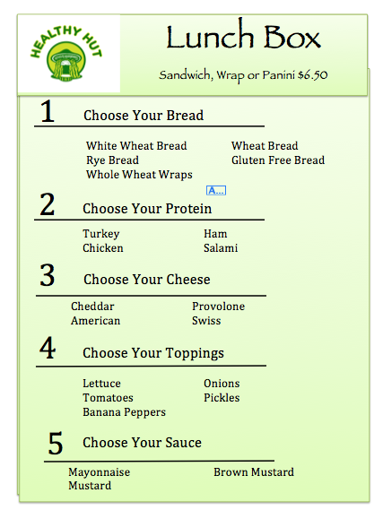
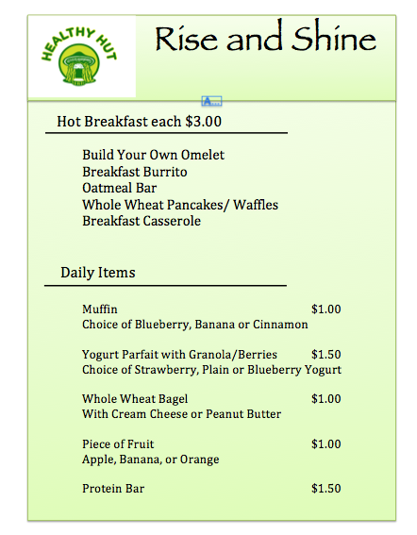
Notes:
Megan

Slide 20
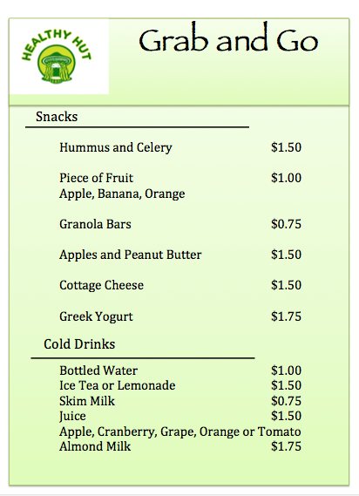
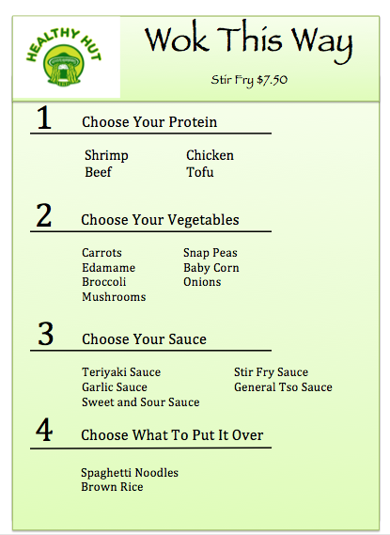
Notes:
Megan

Slide 21
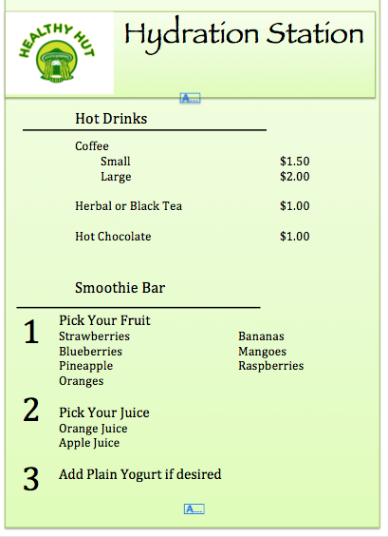
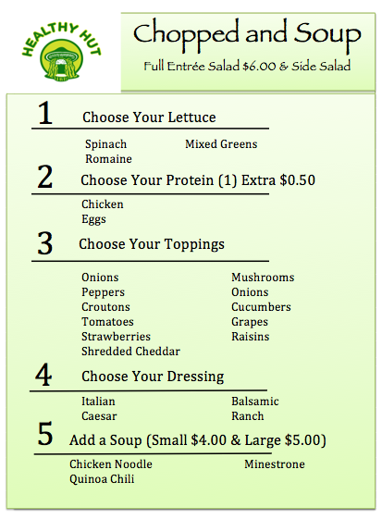
Notes:
Megan

Slide 22
Sample 5-Day Menu
Monday-
8 oz Coffee
Spanish Style Omelette
Stir Fry with 2 cups of rice
1 Container of Greek
Yogurt
1 cup of strawberries
¼ Cup of Trail Mix
Total: $6.46
Tuesday-
8 oz Coffee
Breakfast Burrito
8 oz Milk (1.49/2)
Turkey Sandwich with veggies
1 banana
Carrots
2 T of Hummus
½ Cup of Peppers
Total: $5.77
Wednesday-
1 Container of Greek Yogurt
1 Bottle of Water
Salad
Oatmeal Bar
8 oz Smoothie
Total Cost: $6.42
Thursday-
Pancake Bar
1 Cup of Tea
1 Container of Greek Yogurt
Quinoa Chili
¼ cup of Blueberries
½ cup of Granola
½ cup of Cottage
Cheese
1 oz of Almonds
Total Cost: $6.20
Friday-
8 oz Milk
Breakfast Casserole
8 oz Smoothie
1 cup of Apples
2 Tbsp of Peanut Butter
Shrimp Stir Fry with 2 cups of rice
Total: $5.53
Notes:
Sam

Slide 23
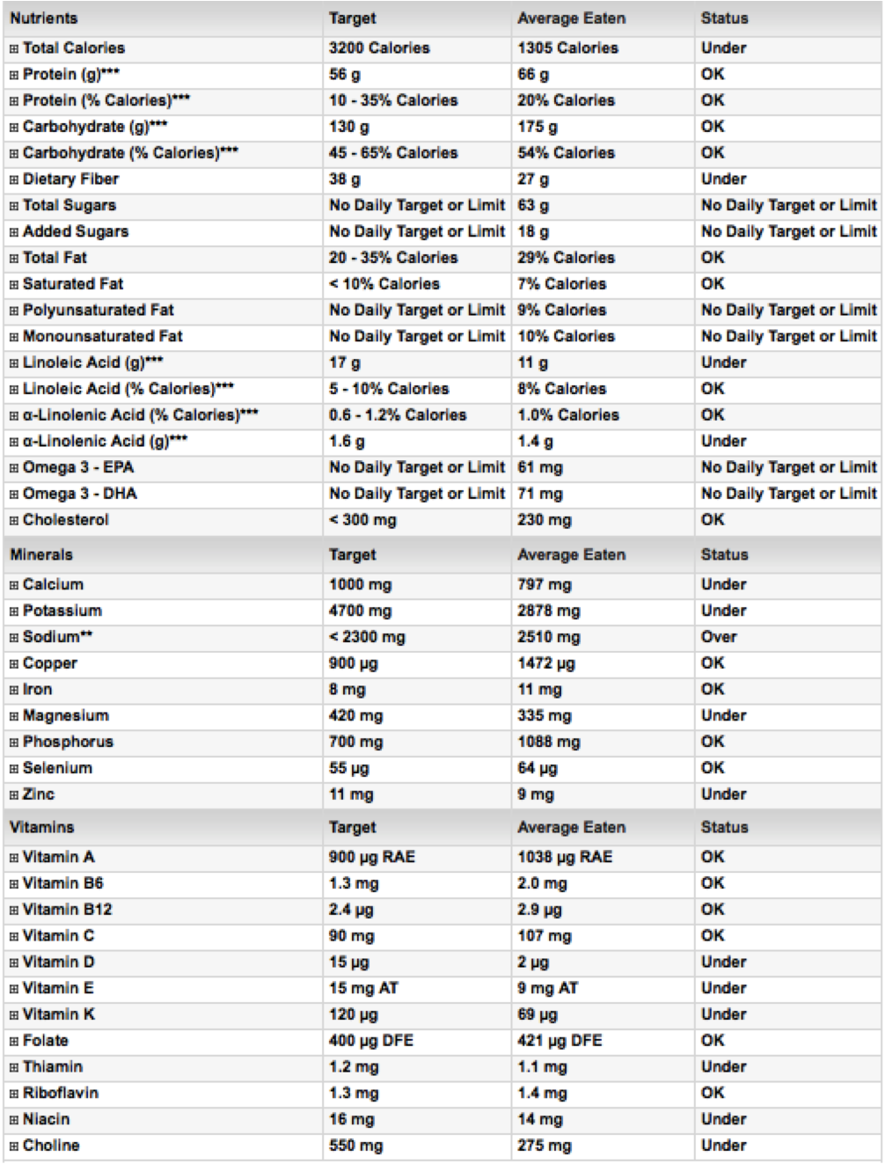
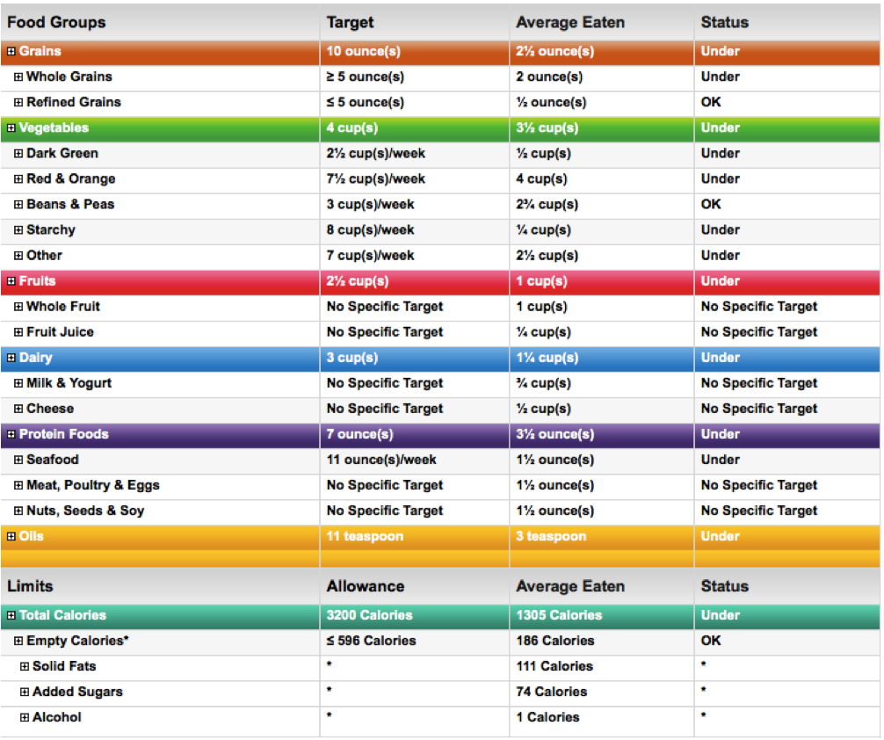
Notes:
Sam

Slide 24
Sample Quantified Recipe: Quinoa Chili
Yields 300 servings
Ingredients
• 50 cup quinoa
• 3 cups and 2 Tablespoon olive oil
• 150 cloves garlic, minced
• 50 onion, diced
• 15 #10 cans diced tomatoes and 10 oz
• 7 #10 cans tomato sauce and 78 oz
• 2 #10 cans diced green chiles and 33 oz
• 4 1/2 cups and 3 tablespoons chili powder, or more, to taste
• 33 Tablespoons and 1 teaspoons cumin
• 1 ¼ cup paprika
• 1 ¼ cup sugar
• 1/2 cup and 1 teaspoon cayenne pepper
• 1/2 cup and 1 teaspoon ground coriander
• Kosher salt and freshly ground black pepper, to taste
• 7 #10 cans kidney beans and 78 ounces (drained and rinsed)
• 7 #10 cans black beans and 78 ounces (drained and rinsed)
• 6 # cans corn kernels and 24 ounces
Instructions
1. In a large saucepan of 6 gallons of water, cook quinoa according to package instructions; set aside.
2. Heat olive oil in a Dutch oven or large pot over medium high heat. Add garlic and onion, and cook, stirring frequently, until onions have become translucent, about 4-5 minutes.
3. Stir in quinoa, diced tomatoes, tomato sauce, green chilies, chili powder, cumin, paprika, sugar, cayenne pepper, coriander and 3 gallons of water, making sure to cover most of the ingredients; season with salt and pepper, to taste.
4. Reduce heat to low; simmer, covered, until thickened, about 45 minutes. Stir in beans, corn, cilantro and lime juice, if using, until heated through, about 5 minutes.
5. Serve immediately with avocado, if desired.
Notes:
Megan

Slide 25
Budget & Funding
Funds will not be segregated from company contributions and assets
Project cost will be roughly 2 million dollars
Payroll is $459,069.00/year or $38,255.75.year
Food cost is roughly $30,000-$40,000 per month
Total cost per month is $73,255.75
We hope to break even by month three of operation (not including project cost). To do so, we will need the projected 600 customers to spend on average $6.10 per day.
Notes:
Connie

Slide 26
Staff
1 Head Chef
1 General Manager/Food Service Director
2 Assistant Managers
1 Intern
28 General Employees
Notes:
Connie

Slide 27
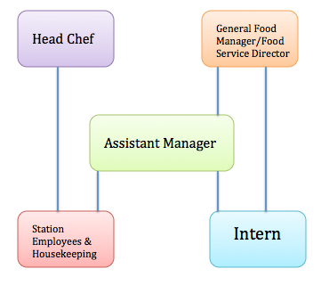
Organizational Chart
Notes:
Connie

Slide 28
Hiring Process
Job Postings
Interview Process
Reference Checks, Criminal Background Checks, Drug and Alcohol Testing
Job Offers
Accepting/Declining Offer
Notes:
Job postings
All regular exempt and nonexempt job openings are posted on JustForTheHealthOfIt.com
and bulletin boards for employees to review. Jobs will remain posted until the position is
filled. Job postings are updated every Wednesdays.
Interview process
The HR department will screen applications and resumes prior to scheduling interviews.
Initial interviews are generally conducted by the HR department and the hiring manager.
Team interviews may be conducted as needed for some positions. If a team interview is
conducted, a structured interview process is recommended. Interview questions should be
compiled by the interviewing team and reviewed by the HR department prior to the
interview. After the team completes the interview process, the results of the interview
should be forwarded to the hiring manager/supervisor for review. The hiring manager or
supervisor has the authority to make the hiring decision.
Reference checks, criminal background checks, and drug and alcohol testing
After a decision has been made to hire a particular candidate, an offer will be made to that
individual on satisfactory completion of reference checks and criminal background checks.
The HR department will check references for all candidates and contact final candidates to
complete a pre-employment drug and alcohol screen.
Job Offers
If the HR department receives satisfactory results from the reference checks, criminal
background check, and the drug and alcohol screen, it or the hiring manager/supervisor
will notify the candidate to confirm the job offer.
Connie

Slide 29
Job Description
Notes:
Connie

Slide 30
Policy: Attendance
It is imperative that every employee be present when scheduled to fulfill customer expectations. Regular attendance and punctuality are essential for the smooth operation of this company.
Vacation and holidays must be scheduled with one’s supervisor in advance (at least 2 days for one or two days; two weeks’ notice for three or more consecutive days).
The first instance of a no-call/no-show will result in a final written warning.
The second separate offense may result in termination of employment with no additional disciplinary steps.
Any no-call/no-show lasting three days is considered job abandonment and will result in immediate termination of employment.
Management may consider extenuating circumstances when determining discipline for a no-call/no-show (for instance, if the employee is in a serious accident and is hospitalized) and has the right to exercise discretion in such cases.
Notes:
Megan

Slide 31
Procedure: Clocking In & Out
Keeping Track of Hours- Clocking In and Out
Employees are required to follow established guidelines for recording their actual hours worked.
Steps-
When arriving to work be properly dressed with apron and hat on
Once properly prepared use employee card and scan at the time clock until it beeps. The time clock is located directly outside of the managers door.
If the time clock is functioning properly, do let the manager know and acquire a time sheet from the office, fill out entirely and place in proper section of the binder based on last name
3.At the end of an employees shift, clock out for the day
Note: Be sure to
Clock in/out at designated time for the meal break
Failure to accurately and timely report time worked.
Clocking in/out at the proper time (not early or late) without receiving prior approval
Notes:
Megan

Slide 32
Procedure: Shift Coverage
If an employee calls out of work the day before, the day of, the manager will review the circumstances of the absence. Based on this review, the manager has the discretion to determine whether to count the incident as a regular occurrence or go directly to issuing a Written Warning. If an employee is already on discipline they can progress to the next level. To log another employee filling one's position, use the attendance log located in the managers office, log the date that needs coverage, the time of the shift, the persons whose shift it is and who will be replacing them. Ensure the person written in the book, that is covering the shift agreed to the time and it then becomes the substitute responsibility to arrive at work.
Notes:
Megan

Slide 33
Training Module for Hydration Station
Notes:
Sam

Slide 37
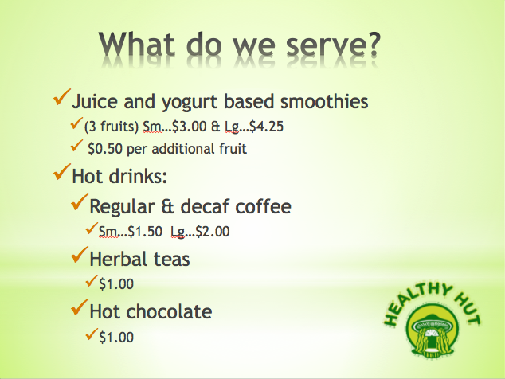

Slide 38
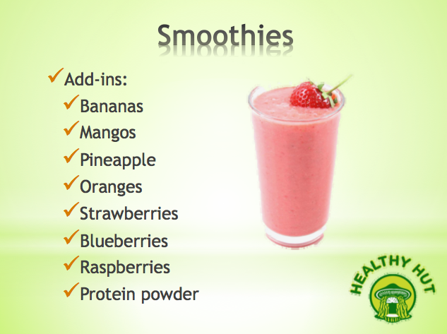

Slide 41
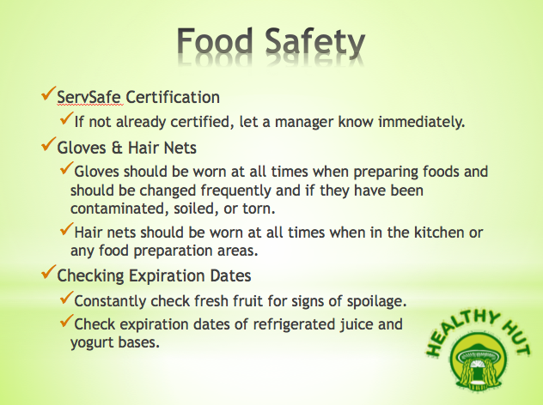

Slide 44
LEED Design Format
(Leadership in Energy & Environmental Design)
Building design and construction that is a holistic green building, which has every sustainability feature, maximizing the benefits of new construction. Our design will incorporate rainwater management, efficient appliances (Energy Star) for reduction in water usage, storage and collection of recyclables including plastics, paper, compost and landfill trash, thermal comfort control of dining facilities and effective use of interior lighting with energy efficiency.
Notes:
Megan

Slide 45
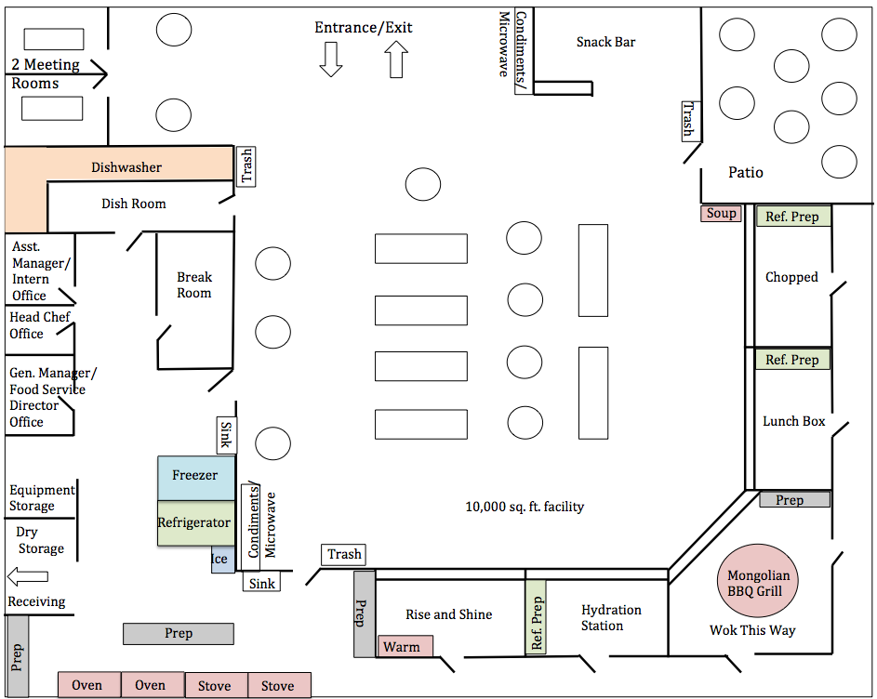
Notes:
Sam

Slide 46
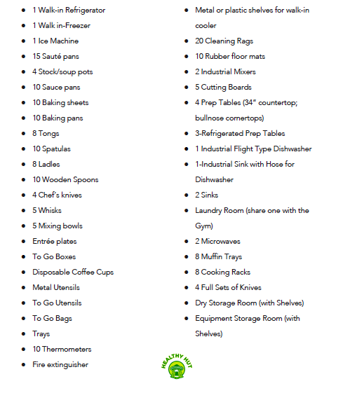
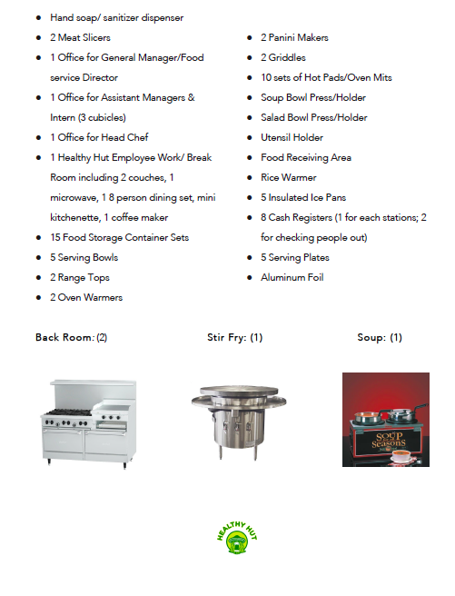
Equipment Needed
Notes:
Connie

Slide 47
Resources
http://www.usgbc.org/leed
http://www.hhs.gov
http://www.clevelandhealth.org
http://www.usda.gov/wps/portal/usda/usdahome
http://www.dol.gov/opa/aboutdol/lawsprog.htm
https://www.supertracker.usda.gov/default.aspx
http://www.hobartcorp.com/products/commercial-dishwashers/ft1000-flight-type
https://www.kroger.com

