Slide 1
Thrifty Gene
Megan Beyer, Erica Carneglia, Corinne Smith

Slide 2
Introduction
Genetic epidemiologist James V. Neel
Enables individuals to collect and store food to deposit fat during abundances of food, provides energy during periods of starvation
Feast Famine Cycle
Notes:
Discovered in 1962

Slide 3
Why is this Important?
Hunters and gatherers
Absence of starvation period today
Obesity and diabetes

Slide 4
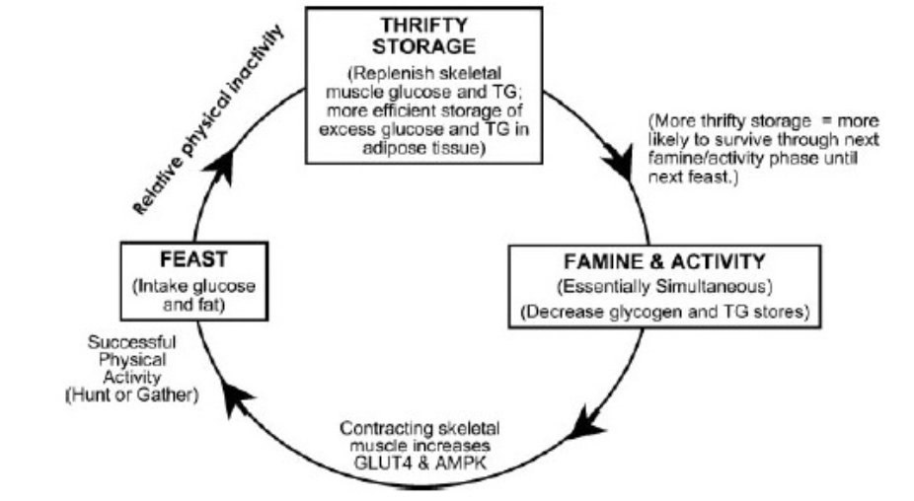

Slide 5
Real Life Application: America
Readily accessible food supply versus overconsumption
Inactivity
Gene predisposition
Metabolic syndrome
Pima Native Americans

Slide 6
Real Life Application: Third World Countries
Scarce food supply
Frequent physical activity
Gene predisposition
Lack of metabolic syndrome

Slide 7
Thrifty Gene In...
Healthy: Less likely to have the thrifty gene or lifestyle choices counteract the gene
Obese: More likely to have the thrifty gene and be displayed in their phenotype
Starving: Utilize the feast-famine cycle

Slide 8
Thrifty Gene and Dietetics
Gene profiling
Nutrition education in portion control, lifestyle modification, and nutrient dense food
More research

Slide 9
References:
Ancient famine-fighting genes can't explain obesity. Science News. 2014. Available at: https://www.sciencenews.org/article/ancient-famine-fighting-genes-cant-explain-obesity. Accessed 2015.
Ayub, Q, Moutsianas, L, Chen, Y, et al. Revisiting the Thrifty Gene Hypothesis via 65 Loci Associated with Susceptibility to Type 2 Diabetes. The American Journal of Human Genetics. 2014:176–185.
Chakravarthy, M.V. & Booth, F.W. Eating, exercise, and “thrifty” genotypes: connecting the dots toward an evolutionary understanding of modern chronic diseases. J Appl Physiol, 96(1), 3-10. Accessed 2015.
Dani, S, Dani, M, Freire, I, et al. Survival of the thriftiest: restricted nurture reveals the thrifty nature of a growth gene in Bos indicus. Genetics and Molecular Research Genet Mol Res. 2010:1032–1044. Accessed November 22, 2015.
Gale, EAM. The thrifty gene hypothesis. The Thrifty Gene Hypothesis. 2014. Available at:http://www.diapedia.org/type-2-diabetes-mellitus/3104683117/the-thrifty-gene-hypothesis. Accessed 2015.
Genomics and Health. Centers for Disease Control and Prevention. 2013. Available at: http://www.cdc.gov/genomics/resources/diseases/obesity/. Accessed 2015.
Graham , W. The Thrifty Gene Hypothesis: Considering the Significance of a 47-year-old Theory. New York Medical College. Available at: https://www.nymc.edu/clubs/quill_and_scope/volume2/graham.pdf. Accessed 2015.
Levitan R, Wendland B. Novel "thrifty" models of increased eating behaviour. Current Psychiatry Reports[serial online]. November 2013;15(11):408. Available from: MEDLINE with Full Text, Ipswich, MA. Accessed November 22, 2015.
Prentice, AM, Hennig, BJ, Fulford, AJ. Evolutionary Origins Of The Obesity Epidemic: Natural Selection Of Thrifty Genes Or Genetic Drift Following Predation Release? International Journal of Obesity. 2008:1607–1610.
Richards, T, Patterson, P. Native American Obesity: An Economic Model of the "thrifty Gene" Theory. American Journal of Agricultural Economics. 2006. Available at: http://www.jstor.org/stable/3697748. Accessed 2015.
Wells J. Thrift: a guide to thrifty genes, thrifty phenotypes and thrifty norms. International Journal Of Obesity [serial online]. December 2009;33(12):1331-1338. Available from: Food Science Source, Ipswich, MA. Accessed November 22, 2015.

